Slide 1
WEEK 8 - DEMO
ANNIE NGUYEN
January 19, 2018

Slide 2


Reddit App

Slide 3
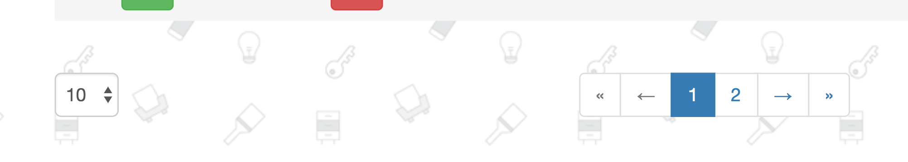
Pagination

Slide 4
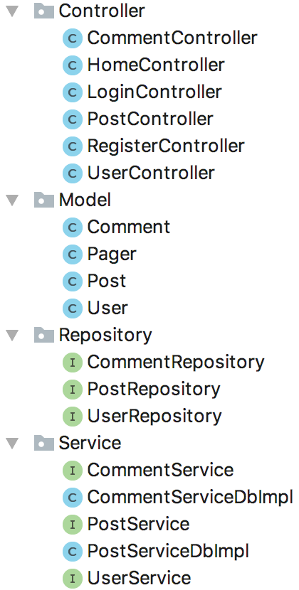
public class Pager { private int numOfButtons = 5; private int firstPageButton; private int finalPageButton; public Pager(int totalPages, int currentPage,
int numOfButtons) { setNumOfButtons(numOfButtons); int halfPagesToShow = getNumOfButtons() / 2; if (totalPages <= getNumOfButtons()) { setFirstPageButton(1); setFinalPageButton(totalPages); } else if (currentPage - halfPagesToShow <= 0) { setFirstButton(1); setFinalButton(getNumOfButtons());

Slide 5
} else if (currentPage + halfPagesToShow == totalPages) { setFirstPageButton(currentPage - halfPagesToShow); setFinalPageButton(totalPages); } else if (currentPage + halfPagesToShow >totalPages){ setFirstPageButton(totalPages
- getNumOfButtons() + 1); setFinalPageButton(totalPages); } else { setFirstButton(currentPage - halfPagesToShow); setFinalButton(currentPage + halfPagesToShow); } }

Slide 6
@Repository public interface PostRepository extends JpaRepository<Post, Long> {}

Slide 7
@GetMapping("/home/{username}") public String getHome(
Model model, HttpServletRequest request, @PathVariable(value = "username") String username, @RequestParam("pageSize") Optional<Integer> pageSize, @RequestParam("page") Optional<Integer> page) { int setPageSize = pageSize.orElse(INITIAL_PAGE_SIZE); int setPage = (page.orElse(0) < 1)
? INITIAL_PAGE : page.get() - 1; Page<Post> posts = postServiceDb.findByPage(
new PageRequest(setPage,setPageSize, Sort.Direction.DESC, "score")); Pager pager = new Pager(posts.getTotalPages(), posts.getNumber(), NUM_OF_BUTTONS); }

Slide 8


Slide 9
THANK YOU FOR
YOUR ATTENTION!

